Slide 1
Intro to the BTC & Tech Recruiting
August 20, 2018

Slide 2
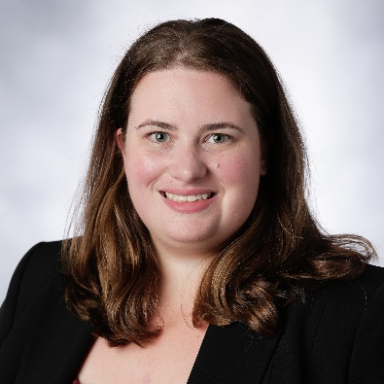

Emily McAdams
President
Hometown: Chapel Hill, NC
MBA Concentration: Operations Management, Data, Digital Analysis, and Technology
Undergraduate College/Major: Cornell University, Electrical and Computer Engineering
Previous Job/Industry: Software Engineer @ Cisco Systems/Tech
Email: Emily_McAdams@kenan-flagler.unc.edu
Internship information
Fun Facts
Summer Internship: Summer Associate at Deloitte
Location: Atlanta, Maine
Summer Highlights: Taking a selfie with Hugh Jackman at the airport in Bangor, ME
Best Tip for Recruiting: Perfect your elevator pitch!
Favorite Class at KFBS (so far): Tech Strategy
Favorite TV Show: Brooklyn 99
Favorite Chapel Hill Spot: BottleRev (wine on tap!) and Med Deli
Ask me about… The places to hang out in Durham

Slide 3
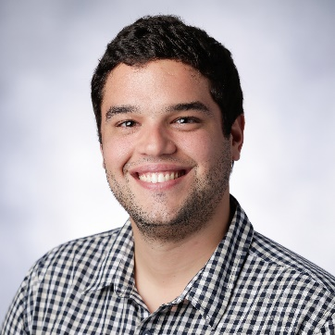
Artur Oliveira
VP, Learning & Development
Hometown: Recife, Brazil
MBA Concentration: Data, Digital Analysis, and Technology
Undergraduate College/Major: University of Wisconsin - Madison, Management & Human Resources, Spanish Linguistics
Previous Job/Industry: Program Manager @ Google
Email: Artur_Oliveira@kenan-flagler.unc.edu
Internship information
Fun Facts
Summer Internship: Senior Product Manager Intern at WebMD
Location: Durham, NC
Summer Highlights: Celebrating my grandparents’ 60th anniversary
Best Tip for Recruiting: Focus your resume on impact, not responsibilities
Favorite Class at KFBS (so far): Data Analytics
Favorite TV Show: House
Favorite Chapel Hill Spot: Kipos
Ask me about… strategies for miles & points travel

Slide 4
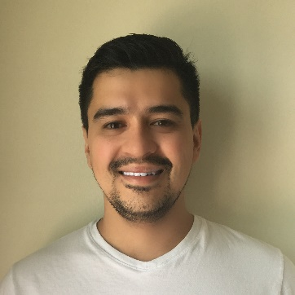
Andre Sakai
VP, Learning & Development
Hometown: Florianopolis, Brazil
MBA Concentration: Marketing, Operations Mgmt, Data, Digital Analysis, and Technology
Undergraduate College/Major: Univ. Federal de Santa Catarina, BR / Business Admn
Previous Job/Industry: Entrepreneur, business owner
Email: Andre_Sakai@Kenan-Flagler.unc.edu
Internship information
Fun Facts
Summer Internship: Business Development at Dell
Location: Austin, TX
Summer Highlights: Food tour in a party bus around Austin!
Best Tip for Recruiting: Perfect your elevator pitch!
Favorite Class at KFBS (so far): Digital Operations
Favorite TV Show: The Big Bang Theory
Favorite Chapel Hill Spot: The Crunkleton (Cocktails) and Kipos
Ask me about… Brazilian food, especially BBQ!

Slide 5
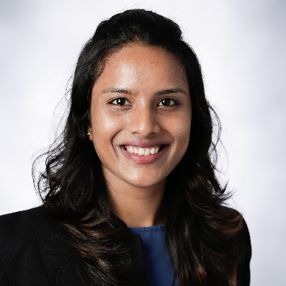
Snehita Peddi
VP, West Coast Relations
Hometown: Hyderabad, India
MBA Concentration: Data, Digital Analysis, and Technology
Undergraduate College/Major: NIT Warangal, Computer Science and Engineering
Previous Job/Industry: Software Engineer @ Microsoft
Email: Snehita_Peddi@kenan-flagler.unc.edu
Internship information
Fun Facts
Summer Internship: Summer Associate at McKinsey & Company
Location: Atlanta
Summer Highlights: Ocean kayaking in San Diego for a Summer conference
Best Tip for Recruiting: Make full use of BCC and career mentor for cover letters and STAR stories
Favorite Class at KFBS (so far): Strategic Innovation
Favorite TV Show: Friends
Favorite Chapel Hill Spot: Spicy 9
Ask me about… Travel stories

Slide 6
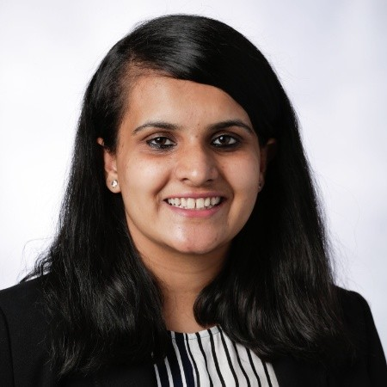
Astha Bali
VP, International Experience
Insert headshot
Hometown: Delhi, India
MBA Concentration: Marketing; Data, Digital Analysis, and Technology
Undergraduate College/Major: University of Delhi, Economics (Hons)
Previous Job/Industry: Multiple roles @ Zomato (Indian foodtech unicorn)
Email: Astha_Bali@kenan-flagler.unc.edu
Internship information
Fun Facts
Summer Internship: Product Manager (RLD) at Amazon
Location: Seattle, Washington
Summer Highlights: Sharing my workplace with the dogs of Amazon!
Best Tip for Recruiting: Understand the company culture and know the role that you are applying for!
Favorite Class at KFBS (so far): STAR
Favorite TV Show: Grey’s Anatomy
Favorite Chapel Hill Spot: Spicy9 at Franklin Street and Pizzeria Toro at Durham
Ask me about… places to eat at Chapel Hill ☺

Slide 7
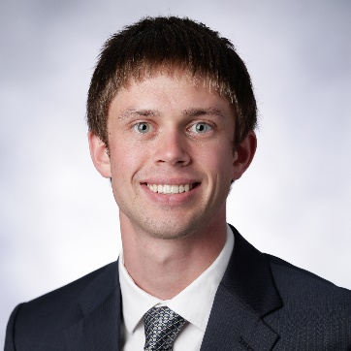
Kevin Stevens
VP, Local Corporate Relations
Hometown: Bloomfield Hills, MI (Suburban Detroit)
MBA Concentration: Marketing & Data, Digital Analysis, and Technology
Undergraduate College/Major: University of Dayton, Electrical Engineering
Previous Job/Industry: Electrical Design Engineer @ NexSens Technology
Email: Kevin_Stevens@kenan-flagler.unc.edu
Internship information
Fun Facts
Summer Internship: Business Strategy – IoT @ Dell
Location: Austin, Texas
Summer Highlights: Tube float down the Comal river
Best Tip for Recruiting: Start early and record your interactions diligently so you remember to follow up
Favorite Class at KFBS (so far): Tech Strategy
Favorite TV Show: Survivor
Favorite Chapel Hill Spot: Backbar @ TOPO
Ask me about… Tennis club or legacy cup events

Slide 8
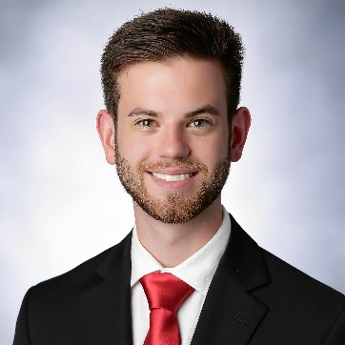
Josh Jessell
VP, Finance
Hometown: Hillsborough, NC
MBA Concentration: Consulting / Marketing, Data, Digital Analysis, and Technology
Undergraduate College/Major: Juniata College, Information Technology and Investing
Previous Job/Industry: Systems Engineer @ Fidelity Investments
Email: Joshua_Jessell@kenan-flagler.unc.edu
Internship information
Fun Facts
Summer Internship: Corporate Innovation Intern at Eastman Chemical Company
Location: Kingsport, TN
Summer Highlights: Visiting Asheville and getting to tour the company private jets
Best Tip for Recruiting: Stay confident in the interview room, you know you better than anyone else.
Favorite Class at KFBS (so far): Tech Strategy
Favorite TV Show: Breaking Bad
Favorite Chapel Hill Spot: Pantana Bobs and Cosmic Cantina (usually following one another)
Ask me about… The STAR Program and why you should apply!

Slide 9
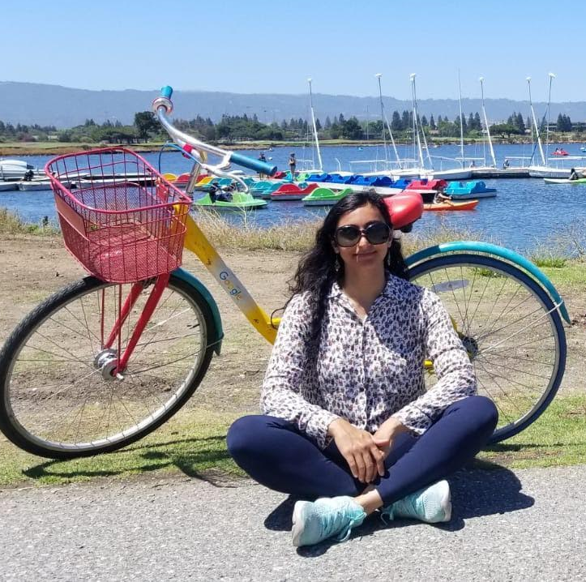
Priyanka Nanda
Hometown: Mumbai, India
MBA Concentration: Marketing
Education
MS Computer Science, University of California, San Diego, USA
BE Computer Engineering, University of Mumbai, India
Previous Job/Industry: Software Developer, OSIsoft
Email: Priyanka_Nanda@kenan-flagler.unc.edu
VP, Communications
Internship information
Summer Internship: PTM, Google
Location: Mountain View, California
Summer Highlights: ML, TGIF, and free everything
Best Tip for Recruiting: Play to your strengths
Fun Facts
Favorite Class at KFBS (so far): Strategic Innovation
Favorite Hobbies: Dancing, Hiking, Swimming
Favorite Spot: Maple View Farm Ice Cream
Ask me about… Tech, Travel

Slide 10
The Role of BTC in Tech Recruiting
Collaborate closely with C&L
14 Career Lab Sessions
  Learn More About Tech: Training Tech’ Sessions
  C&L sessions: ‘Breaking into Tech’, ‘Roles in Tech’
  Improve Your Skills Workshops: ‘Resume Walks’, ‘Informational Interview Practice’, and more
  Alumni panels & other tech-related events
2Y Coffee Chats
  Network with 2Ys who recruited & interned in Tech
  Mock interviews, practice informational calls, resume reviews, and more
Alumni Connections & Mentoring Programs
  Connect BTC members with alumni at top tech companies
  Mentorship Programs
International Student Support

Slide 11
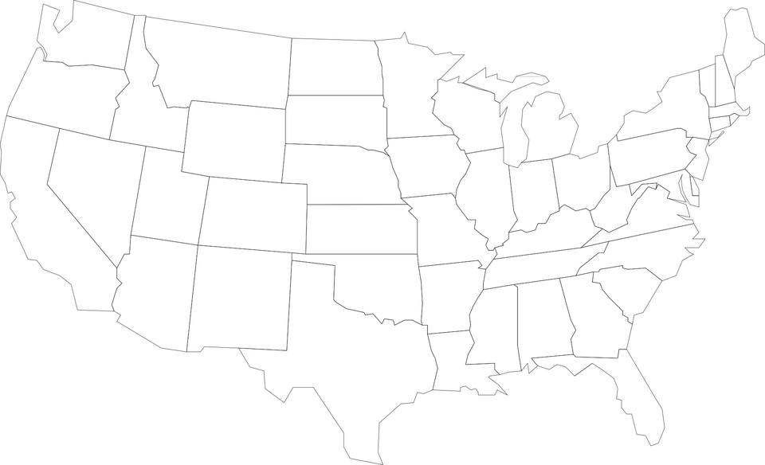











Locations for Tech Internships | Total 58 Internships

Slide 12
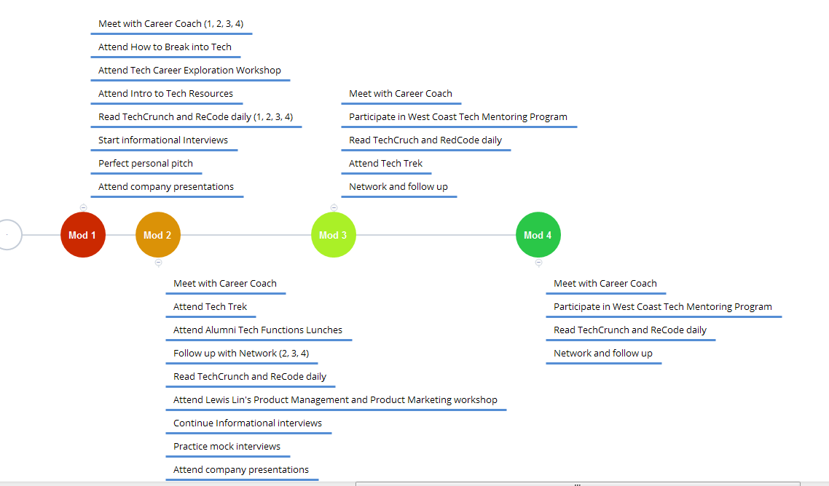
Tech Recruiting Timeline
What BTC Provides

Slide 13
Tech Recruiting Timeline
What you should be doing on your own!

Slide 14

Myths of Tech Recruiting
You don’t need to network for tech
You don’t need to worry about tech recruiting until January or later

Slide 15
BTC Liaisons
Shadow and learn from current BTC VPs
Take an active role assisting and planning events for the BTC
Demonstrate your interest in tech and get more exposure to employers as a leader in the organization
Application information will be shared early next week
If you are interested, schedule a coffee chat with the corresponding VP and learn more about the position and expectations

Slide 16
BTC Calendar
Date | Title
20-Aug | Career Lab Overview
22-Aug | Career Club Kick-Off
24-Aug | MBASA Activity Fair
27-Aug | Company Presentation and Office Hours Best Practices, BTC 2Y Recruiting Panel
29-Aug | BTC, Ops Mgmt, GM Networking Night
10-Sep | Networking Forum & Diversity Conference Prep (Resume Walk and Pitch Practice)
17-Sep | Informational Call Best Practices & Preparing Cover Letters (workshop focused on Tech Recruiting)
24-Sep | Realities of Tech Recruiting with Jeremy Schifeling
1-Oct | Exploring Roles in Tech with Jeremy Schifeling
Week of 8-Oct | Making the Most of the Career Trek
8-Oct | Off-Campus Recruiting for Tech Part 1
15-Oct to 19-Oct | WEST COAST TREK
22-Oct | Off-Campus Recruiting for Tech Part 2
29-Oct | Intro to Tech Interviews (Behavioral, Casing)
5-Nov | Teaching Tech - Session 1
12-Nov | Tech Casing Overview
19-Nov | Behavioral Interviewing Workshop
26-Nov | Tech Casing Workshop
30-Nov | Lewis Lin-Prep for Product Management and Product Marketing
3-Dec | Teaching Tech - Session 2
10-Dec | Maximize Your Winter Break
All BTC Career Labs will be held in McColl 2250
Local Career Treks will be held on Fridays thoughout Mod I, II

Slide 17
Next Steps
Time/Date | Event
5-6 PM August 22nd | Career Mentor Meet and Greet
6-8 PM August 22nd | Career Club Kick-Off
5-7 PM August 23rd | Activity Fair and Club Sign-Up (be sure to sign up for the BTC mailing list!)
12:30-2PM August 27th | 2nd Tech Career Lab: Company Presentation and Office Hours plus 2Y Panel on Tech Recruiting
5-7PM August 29th | Club Kick-Off with Ops Mgmt and General Management Club
8-10PM August 29th | Networking Night @ Might as Well
August 31st | BTC Liaison Applications Due!

Slide 18
Questions?

